Slide 1
CS225/CS226

Slide 2
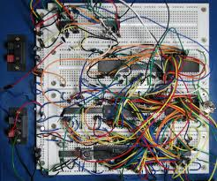
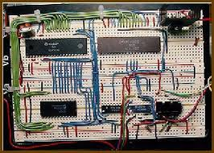
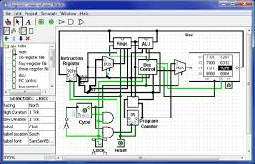
So far

Slide 3
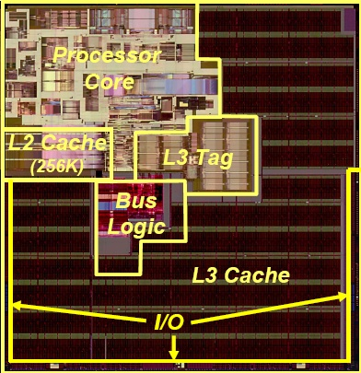
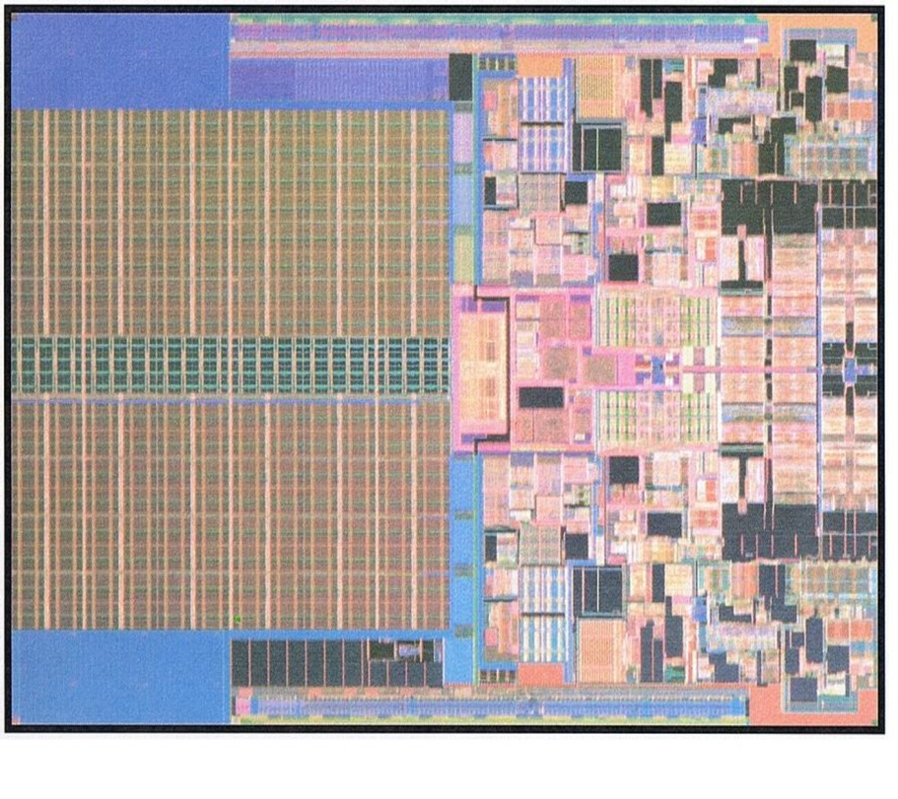
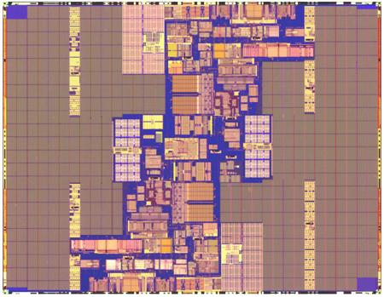
Modern System
Core 0
L2 Cache
6MB
L2 Cache
6MB
Itanium 2* (L3-9MB)
130nm Technology
L1
Core 1
Penryn (dual-core)
45nm Technology
L2
L2
Montecito* (dual-core)
(L2-24MB, L1-2MB)
90nm Technology
L1
V. George et al., “Penryn: 45-nm Next Generation Intel® Core™ 2 Processor,” Proceedings of the IEEE Solid-State Circuits Conference,
*Intel

Slide 4















Different versions
Silicon Process Technology
1.5µ 1.0µ 0.8µ 0.6µ 0.35µ 0.25µ 0.18µ 0.13µ
Intel386™ DX Processor
Intel486™ DX Processor
Pentium®
Processor
Pentium® Pro Processor
Pentium® II Processor
Pentium® III Processor
Pentium® 4 Processor
Notes:
P-III sizes –
0.25u 140 mm^2, 9.5 M trans 0KB L2;
01.8 106 mm^2, 28M Trans, 128KB L2;
01.3 79 mm^2, 40M Trans, 512KB L2
P4P sizes –
W 1.75V 2GHZ 75 Watts 217mm^2 42M trans, 256KB L2
N 1.5V 2GHZ 52W, 2.2GHZ 55W 146mm^2 55M tran 512KB L2

Slide 5


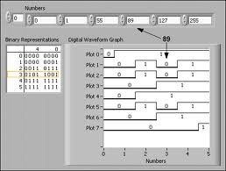
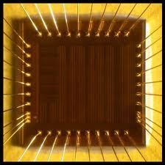
Basic Design Methodology
Requirements
RTL Model
Simulate
Synthesize
Gate-level
Model
Simulate
Test Bench
ASIC or FPGA
Place & Route
Timing
Model
Simulate

Slide 6
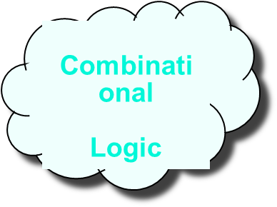
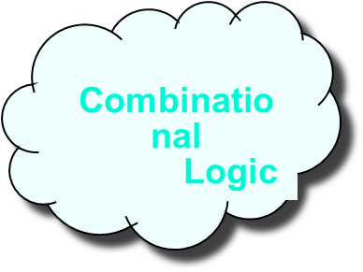
Register Transfer Level (RTL) Design Description
Today’s Topic
…
Registers

Slide 7
Basic Design Methodology
Verilog
Always
inst1
inst2
inst3
Synthesis
mapping
Place and Route
clb 1
clb 2

Slide 8
What is Verilog HDL?
Verilog Hardware Description Language(HDL)?
  A high-level computer language can model, represent and simulate digital design
    Hardware concurrency
    Parallel Activity Flow
    Semantics for Signal Value and Time
  Design examples using Verilog HDL
    Intel Pentium, AMD K5, K6, Atheon, ARM7, etc
    Thousands of ASIC designs using Verilog HDL

Slide 9
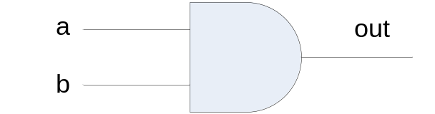
VERILOG HDL
Basic Unit – A module
Module
  Describes the functionality of the design
  States the input and output ports
Example:
module and_gate(out, a,b);
output out ;
input a, b;
assign out = a & b;
endmodule

Slide 10
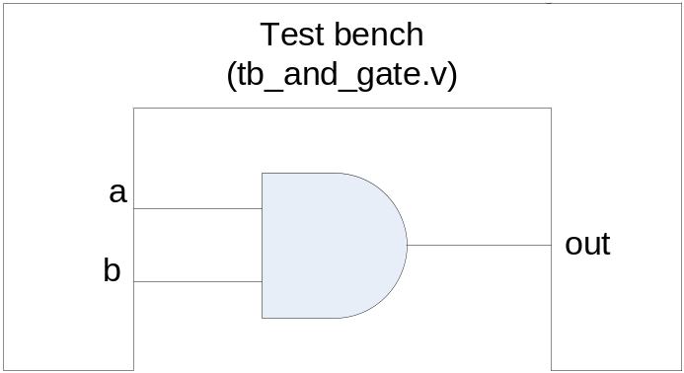
Testing AND gate
Instantiate a module
  apply test
module tb_and_gate();
reg a,b;
wire out;
and_gate uut (out,a,b); // this instantiates a and gate, uut is a label
initial
begin
a = 1'b0; // here we apply inputs to the gate
b = 1'b0;
#10;
a = 1'b0;
b = 1'b1;
#10;
a = 1'b1;
b = 1'b1;
#10;
a = 1'b1;
b = 1'b0;
#10;
End
endmodule
uut

Slide 11
Different Levels of Abstraction
Algorithmic
  the function of the system
RTL
  the data flow
  the control signals
  the storage element and clock
Gate
  gate-level net-list
Switch
  transistor-level net-list

Slide 12
How Are Simulators Used?
Testbench generates stimulus and checks response
Coupled to model of the system
Pair is run simultaneously
Testbench
System Model
Stimulus
Response
Result checker

Slide 13
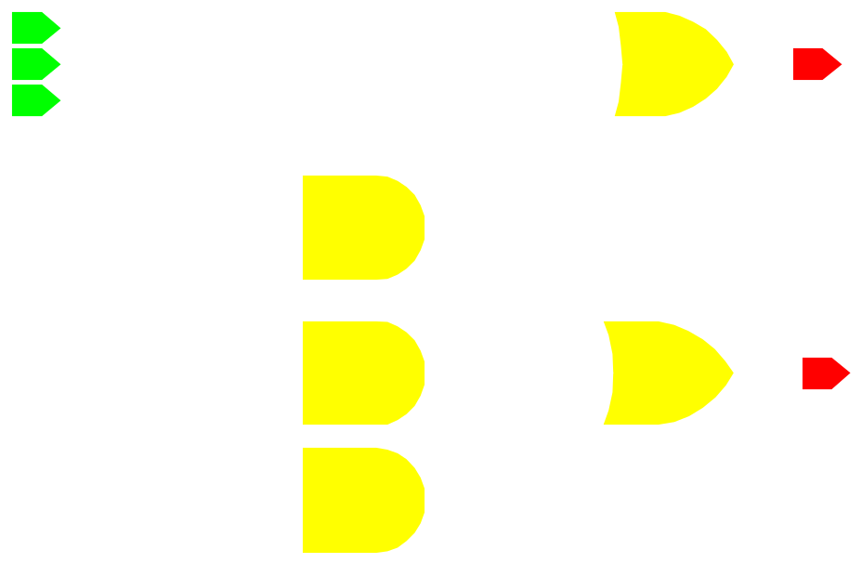
Sample Design
module fadder ( sum, cout, a, b , ci );
// port declaration
output sum, cout;
input a, b, ci;
reg sum, cout;
// behavior description
always @( a or b or ci )
begin
sum = a ^ b ^ ci;
cout = ( a&b ) | ( b&ci ) | ( ci&a);
end
endmodule
1-bit full adder
sum
a
b
ci
cout

Slide 14
Writing Testbenches
Inputs to device under test
module test;
reg a, b, sel;
mux m(y, a, b, sel);
initial begin
$monitor($time,, “a = %b b=%b sel=%b y=%b”,
a, b, sel, y);
a = 0; b= 0; sel = 0;
#10 a = 1;
#10 sel = 1;
#10 b = 1;
end
Device under test
$monitor is a built-in event driven “printf”
Stimulus generated by sequence of assignments and delays

Slide 15
Structural Modeling
When Verilog was first developed (1984) most logic simulators operated on netlists
Netlist: list of gates and how they’re connected
A natural representation of a digital logic circuit
Not the most convenient way to express test benches

Slide 16
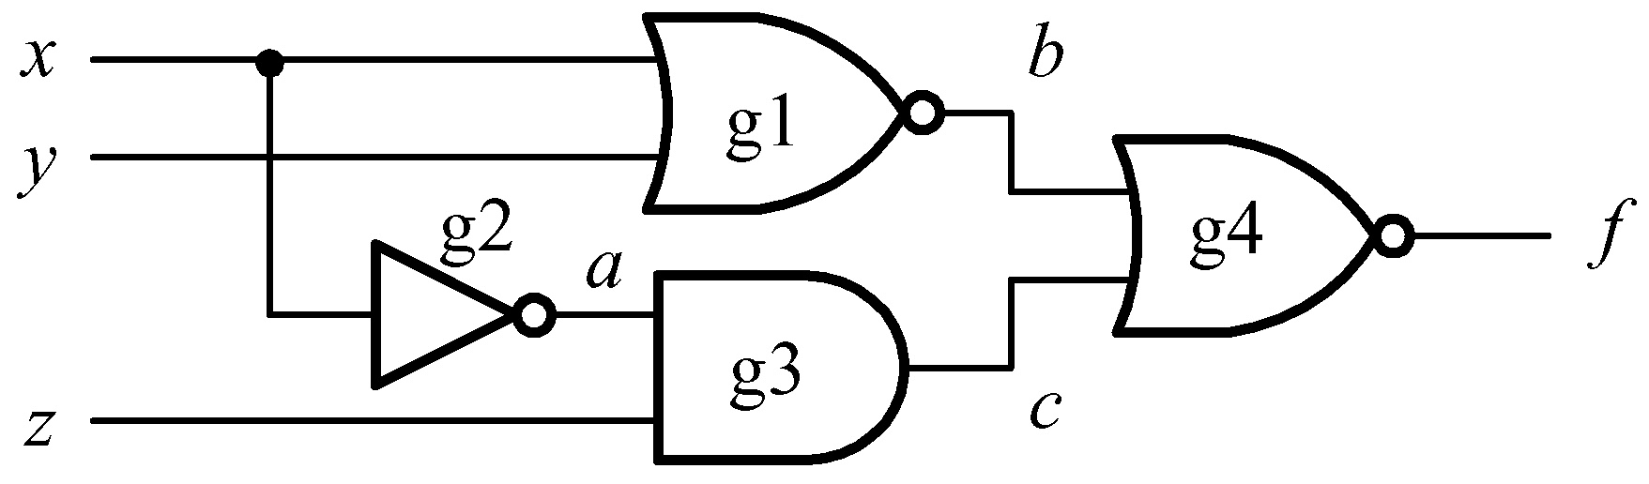
Module basic_gates
module basic_gates (x, y, z, f) ;
input x, y, z;
output f ;
wire a, b, c;
// Structural modeling
nor g1 (b, x, y);
not g2 (a, x);
and g3 (c, a, z);
nor g4 (f, b, c);
endmodule

Slide 17
Behavioral Modeling
A much easier way to write testbenches
Also good for more abstract models of circuits
  Easier to write
  Simulates faster
More flexible
Provides sequencing
Verilog succeeded in part because it allowed both the model and the testbench to be described together

Slide 18
Two Main Components of Verilog
Concurrent, event-triggered processes (behavioral)
  Initial and Always blocks
  can perform standard data manipulation tasks (assignment, if-then, case)
  Processes run until they delay for a period of time or wait for a triggering event
Structure (Plumbing)
  Verilog program build from modules with I/O interfaces
  Modules may contain instances of other modules
  Modules contain local signals, etc.
  Module configuration is static and all run concurrently

Slide 19
Two Main Data Types
Nets represent connections between things
  Do not hold their value
  Take their value from a driver such as a gate or other module
  Cannot be assigned in an initial or always block
Regs represent data storage
  Behave exactly like memory in a computer
  Hold their value until explicitly assigned in an initial or always block
  Can be used to model latches, flip-flops, etc., but do not correspond exactly

Slide 20
Description Styles
Example
module HalfAdder (A, B, Sum Carry);
input A, B;
output Sum, Carry;
assign Sum = A ^ B;
//^ denotes XOR
assign Carry = A & B;
// & denotes AND
endmodule
General definition
module module_name ( port_list );
port declarations;
…
variable declaration;
…
description of behavior
endmodule
A
Half adder
Carry
B
sum

Slide 21
Description Styles (cont.)
module mux1( select, d, q );
input[1:0] select;
input[3:0] d;
output q;
wire q;
wire[1:0] select;
wire[3:0] d;
assign q = d[select];
endmodule

Slide 22
Description Styles (cont.)
Behavioral: Algorithmically specify the behavior of the design
Example:
always @( select or a or b ) begin
if (select == 0) begin
out = b;
end
else if (select == 1) begin
out = a;
end
end
a
Black Box
2x1 MUX
out
b
sel

Slide 23
Description Styles (cont.)
module mux1( select, d, q );
input[1:0] select;
input[3:0] d;
output q;
wire q;
wire[1:0] select;
wire[3:0] d;
assign q = d[select];
endmodule

Slide 24
Description Styles (cont.)
module mux2( select, d, q );
input[1:0] select;
input[3:0] d;
output q;
reg q;
wire[1:0] select;
wire[3:0] d;
always @(d or select)
q = d[select];
endmodule

Slide 25
Description Styles (cont.)
module mux3( select, d, q );
input[1:0] select;
input[3:0] d;
output q; reg q;
wire[1:0] select;
wire[3:0] d;
always @( select or d ) begin
if( select == 0)
q = d[0];
if( select == 1)
q = d[1];
if( select == 2)
q = d[2];
if( select == 3)
q = d[3];
end endmodule

Slide 26
Description Styles (cont.)
module mux4( select, d, q );
input[1:0] select;
input[3:0] d;
output q;
reg q;
always @( select or d )
begin
case( select )
0 : q = d[0];
1 : q = d[1];
2 : q = d[2];
3 : q = d[3];
endcase
end
endmodule

Slide 27
Four-valued Data
Verilog’s nets and registers hold four-valued data
0, 1
  Obvious
Z
  Output of an undriven tri-state driver
X
  Models when the simulator can’t decide the value
  Initial state of registers
  When a wire is being driven to 0 and 1 simultaneously

Slide 28
Four-valued Logic
Logical operators work on three-valued logic
0 1 X Z
0 0 0 0 0
1 0 1 X X
X 0 X X X
Z 0 X X X
Output 0 if one input is 0
Output X if both inputs are gibberish

Slide 29
Nets and Registers
Wires and registers can be bits, vectors, and arrays
wire b[3:0];
wire a; // Simple wire
reg [5:0] vec; // Six-bit register
integer imem[0:1023]; // Array of 1024 integers
reg [31:0] dcache[0:63]; // A 32-bit memory
reg [31:0] regfile [0:63]; // 64 registers each 32 bit

Slide 30
Modules and Instances
Basic structure of a Verilog module:
module mymod(output1, output2, … input1, input2);
output output1;
output [3:0] output2;
input input1;
input [2:0] input2;
…
endmodule
Verilog convention lists outputs first

Slide 31
Instantiating a Module
Instances of
module mymod(y, a, b);
look like
mymod mm1(y1, a1, b1); // Connect-by-position
mymod (y2, a1, b1),
(y3, a2, b2); // Instance names omitted
mymod mm2(.a(a2), .b(b2), .y(y2)); // Connect-by-name

Slide 32
Gate-level Primitives
Verilog provides the following:
and nand logical AND/NAND
or nor logical OR/NOR
xor xnor logical XOR/XNOR
buf not buffer/inverter

Slide 33
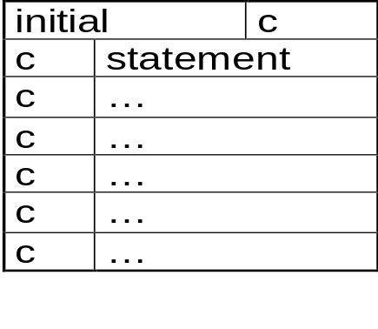
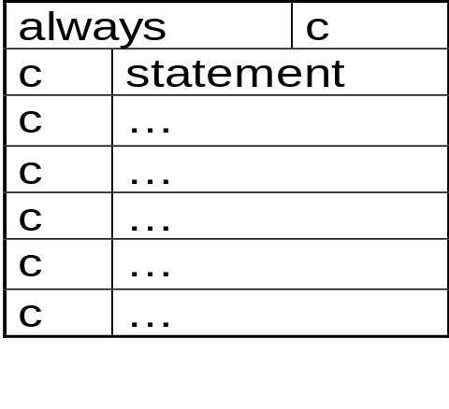
Initial and Always Blocks
Basic components for behavioral modeling
always
begin
statements …
end
Runs when simulation starts
Restarts when control reaches the end
Good for modeling/specifying hardware
initial
begin
statements …
end
Runs when simulation starts
Terminates when control reaches the end
Good for providing stimulus

Slide 34
Initial and Always
Run until they encounter a delay
initial begin
#10 a = 1; b = 0;
#10 a = 0; b = 1;
end
or a wait for an event
always @(posedge clk)
q = d;
always
begin wait(i); a = 0;
wait(~i); a = 1;
end

Slide 35
Binary Literals
Valid digits:0,1,z,Z,?,x,X
(one bit per digit)
Zero-filled to 32 bits
  Filled with z or x if most significantt bit
Syntax ‘b<digit> or ‘B<digit>
Example
  ‘b0 0000 0000 … 0000
  ‘b1 0000 0000 … 0001
  ‘B1 0000 0000 … 0001
  ‘bx xxxx xxxx … xxxx
  ‘b10x 0000 0000 … 010x

Slide 36
Decimal Literals
Valid digits:0, 1, ..9
(No X or Z)
No bitwise correspondence
Zero filled to 32 bits
Syntax ‘d<digit> or ‘D<digit>
Example
  ‘d0 0000 0000 … 0000
  ‘d1 0000 0000 … 0001
  ‘D1 1 0000 0000 … 1011

Slide 37
Hexadecimal Literals
Valid digits:0-9, a-f, A-F, z, Z, ?, x, X
Four bits per digit
Zero filled to 32 bits
Syntax ‘h<digit> or ‘ H<digit>
Example
  ‘h0 0000 …00000000
  ‘h1 0000 …00000001
  ‘h1 1 0000 …00010001
  ‘hx xxxx …xxxxxxxx
  ‘h17xz 000 … 0010111xxxxzzzz

Slide 38
Size of Literals
By default 32 bit:
Example
  ‘b0 0000 0000 … 0000
  ‘b1 0000 0000 … 0001
  ‘h1 0000 0000 … 0001
  ‘h0F 0000 0000 … 1111
  ‘d1 0000 0000 … 0001
  ‘d14 0000 0000 … 1110

Slide 39
Sized Literals
To specify number of bits different from 32
For any literal base
Extra bits are truncated
example
  1’b0 1
  ‘b1 0000 0000 … 0001
  8‘b1 0000 0001
  8‘h0F 00001111
  8‘d256 0000 0000
  5‘d14 01110

Slide 40
Integer/Real Literals
Valid digits: 0-9
2’s compliment
example
  1 0000000 … 0000000001
  -1 11111111…11111111111
  0000000 … 0000100011
Real : Double precision (64 bits) floating point
Syntax: [-] <digit>.<digit> E[-] <digit>
example: 0.0
1.0
1.0E-9

Slide 41
Logical Values
Any non-zero value is TRUE
Anything else if FALSE
  Including ‘x’ and ‘z’
examples
1’b0 FALSE
1’b1 TRUE
1’bX FALSE
3’b000 FALSE
3’b10X TRUE
3’b00X FALSE

Slide 42
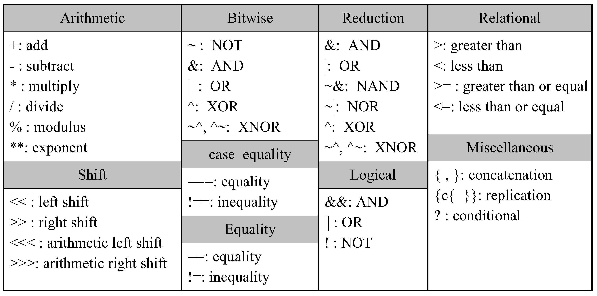
Operators

Slide 43
Bitwise Operators
~ <expr> bitwise not
<expr> & <expr> bitwise and
<expr> | <expr> bitwise or
<expr> ^ <expr> bitwise xor
examples
~3’b101 3’b010
3’b101 & 3’b111 3’b101
3’b101 | 3’b111 3’b111
3’b101 ^ 3’b111 3’b010

Slide 44
Reduction Operators
& <expr> and- reduction
| <expr> or- reduction
^ <expr> xor- reduction
examples
& 3’b011 1b0
& 3’b111 1b1
& 3’b11x 1bx
& 3’b01x 1b0
| 3’b011 1b1
| 3’b000 1b0
| 3’b11x 1b1
| 3’b00x 1bx
^ 3’b001 1b1
^ 3’b111 1b1
^ 3’b11x 1bx

Slide 45
Vector Operators
<expr> << <expr> Logic shift left
<expr> >> <expr> Logic shift right
{<expr> , <expr>} Concatenation
{<cont-expr>{expr}} Replication
examples
3’b101 << 1 3’b010
3’b101 >> 2 3’b001
{3’b111, 1’b0} 4’b1110
{3 {2’b01}} 6’b010101

Slide 46
Relational Operators
<expr> == <expr> equal
<expr> !> <expr> not equal
<expr> === <expr> identical
<expr> !== <expr> not identical
examples
3’b101 == 3’b010 ‘1b0 (False)
3’b101 != 3’b010 ‘1b1 (True)
3’b0x1 == 3’b0x1 ‘1b0 (False)
3’b0x1 === 3’b0x1 ‘1b1 (True)

Slide 47
Relational Operators
<expr> < <expr> less than
<expr> <= <expr> less than or equal
<expr> > <expr> greater than
<expr> !== <expr> greater than or equal
examples
3’b101 < 3’b010 ‘1b0
3’b111 > 3’b010 ‘1b1
-1 < 1 ‘1b1

Slide 48
Logical Operators
! <expr> logical not
<expr> && <expr> logical and
<expr> || <expr> logical or
examples
! 3’b001 ‘1b0 (False)
3’b001 && 3’b100 ‘1b1 (True)
3’b001 & 3’b100 ‘3b000 (False)
3’b001 || 3’b100 ‘1b1 (True)

Slide 49
Combinational Circuit Design
Outputs are functions of inputs
Examples
  MUX
  decoder
  priority encoder
  adder
inputs
comb.
circuits
Outputs

Slide 50
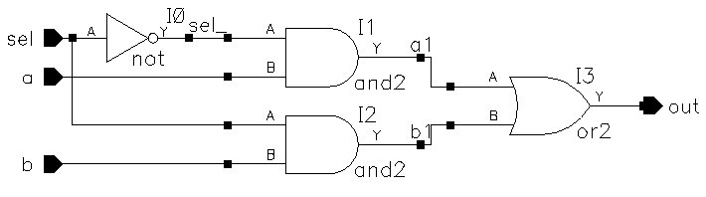
Multiplexor
Net-list (gate-level)
  module mux2_1 (out,a,b,sel) ;
    output out ;
    input a,b,sel ;
    not (sel_, sel) ;
    and (a1, a, sel_) ;
    and (b1, b, sel) ;
    or (out, a1, b1) ;
  endmodule

Slide 51
Multiplexor
Continuous assignment
  module mux2_1 (out,a,b,sel) ;
    output out ;
    input a,b,sel ;
    assign out = (a&~sel)|(b&sel) ;
  endmodule
RTL modeling
    always @(a or b or sel)
    if(sel)
      out = b;
    else
      out = a;

Slide 52
Multiplexor
4-to-1 multiplexor
  module mux4_1 (out, in0, in1, in2, in3, sel) ;
  output out ;
  input in0,in1,in2,in3 ;
  input [1:0] sel ;
  assign out = (sel == 2'b00) ? in0 :
  (sel == 2'b01) ? in1 :
  (sel == 2'b10) ? in2 :
  (sel == 2'b11) ? in3 :
  1'bx ;
  endmodule

Slide 53
Multiplexor
  module mux4_1 (out, in, sel) ;
  output out ;
  input [3:0] in ;
  input [1:0] sel ;
  reg out ;
  always @(sel or in) begin
  case(sel)
  2’d0: out = in[0] ;
  2’d1: out = in[1] ;
  2’d2: out = in[2] ;
  2’d3: out = in[3] ;
  default: 1’bx ;
  endcase
  end
  endmodule

Slide 54
Top-Down Design – Combinational Behavior to Structure
Procedures with If-Else Statements
`timescale 1 ns/1 ns
module Dcd2x4(I1, I0, D3, D2, D1, D0);
input I1, I0;
output D3, D2, D1, D0;
Q: Create procedure describing behavior of a 2x4 decoder using if-else-if construct
reg D3, D2, D1, D0;
always @(I1, I0)
begin
if (I1==0 && I0==0)
begin
D3 <= 0; D2 <= 0;
D1 <= 0; D0 <= 1;
end
else if (I1==0 && I0==1)
begin
D3 <= 0; D2 <= 0;
D1 <= 1; D0 <= 0;
end
else if (I1==1 && I0==0)
begin
D3 <= 0; D2 <= 1;
D1 <= 0; D0 <= 0;
end
else
begin
D3 <= 1; D2 <= 0;
D1 <= 0; D0 <= 0;
end
end
endmodule
D0
I0
D1
I1
D2
D3
2x4 decoder
Order of assignment statements does not matter.
Placing two statements on one line does not matter.
To execute multiple statements if expression is true, enclose them between "begin" and "end"

Slide 55
Decoder
3-to 8 decoder with an enable control
  module decoder(o,enb_,sel) ;
  output [7:0] o ;
  input enb_ ;
  input [2:0] sel ;
  reg [7:0] o ;
  always @ (enb_ or sel)
  if(enb_)
    o = 8'b1111_1111 ;
  else
  case(sel)
  3'b000 : o = 8'b1111_1110 ;
  3'b001 : o = 8'b1111_1101 ;
  3'b010 : o = 8'b1111_1011 ;
  3'b011 : o = 8'b1111_0111 ;
  3'b100 : o = 8'b1110_1111 ;
  3'b101 : o = 8'b1101_1111 ;
  3'b110 : o = 8'b1011_1111 ;
  3'b111 : o = 8'b0111_1111 ;
  default : o = 8'bx ;
  endcase
  endmodule

Slide 56
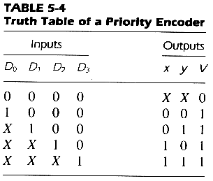
Priority Encoder
  always @ (d0 or d1 or d2 or d3)
    if (d3 == 1)
      {x,y,v} = 3’b111 ;
    else if (d2 == 1)
      {x,y,v} = 3’b101 ;
    else if (d1 == 1)
      {x,y,v} = 3’b011 ;
    else if (d0 == 1)
      {x,y,v} = 3’b001 ;
    else
      {x,y,v} = 3’bxx0 ;

Slide 57
Parity Checker
always @ (data)
begin: check_parity
reg partial;
integer n;
partial = data[0];
for ( n = 0; n <= 7; n = n + 1)
begin
partial = partial ^ data[n];
end
parity = partial;
end
endmodule
module parity_chk(data, parity);
input [0:7] data;
output parity;
reg parity;

Slide 58
Left shift 2
module leftshift2_32(input [31:0] a, output [31:0] y);
assign y = {a[29:0], 2'b0};
endmodule
module zeroext4_8(input [3:0] a, output [7:0] y);
assign y = {4'b0, a};
endmodule

Slide 59
Test Bench
module testbench2(); reg a, b, c; wire y;
example dut(a, b, c, y);
// apply inputs one at a time; // checking results
initial begin
a = 0; b = 0; c = 0; #10;
if (y !== 1) $display("000 failed.");
c = 1; #10;
if (y !== 0) $display("001 failed.");
b = 1; c = 0; #10;
if (y !== 0) $display("010 failed.");
c = 1; #10;
if (y !== 0) $display("011 failed.");
a = 1; b = 0; c = 0; #10;
if (y !== 1) $display("100 failed.");
c = 1; #10;
if (y !== 1) $display("101 failed.");
b = 1; c = 0; #10;
if (y !== 0) $display("110 failed.");
c = 1; #10;
if (y !== 0) $display("111 failed."); end
endmodule

Slide 60
Test Bench
module testbench3();
reg clk, reset;
reg a, b, c, yexpected;
wire y;
reg [31:0] vectornum, errors;
reg [3:0] testvectors[10000:0];
// instantiate device under test
example dut(a, b, c, y);
// generate clock
always
begin
clk = 1; #5; clk = 0; #5;
end
// at start of test, load vectors // and pulse reset
initial
begin
$readmemb("example.tv", testvectors);
vectornum = 0; errors = 0;
reset = 1; #27; reset = 0;
end
// apply test vectors on rising edge of clk
always @(posedge clk)
begin
#1; {a, b, c, yexpected} = testvectors[vectornum];
end
// check results on falling edge of clk
always @(negedge clk)
if (~reset) begin // skip cycles during reset
if (y !== yexpected) begin // check result
$display("Error: inputs = %b",
{a, b, c});
$display(" outputs = %b (%b expected)",
y, yexpected);
errors = errors + 1;
end
vectornum = vectornum + 1;
if (testvectors[vectornum] === 4'bx) begin
$display("%d tests completed with %d errors",
vectornum, errors);
$finish;
end
end
endmodule

Slide 61
Test Bench

Slide 62
Adder
RTL modeling
  module adder(c,s,a,b) ;
  output c ;
  output [7:0] s ;
  input [7:0] a,b ;
  assign {c,s} = a + b ;
  endmodule
Logic synthesis
  CLA(carry look ahead) adder for speed optimization
  ripple adder for area optimization

Slide 63
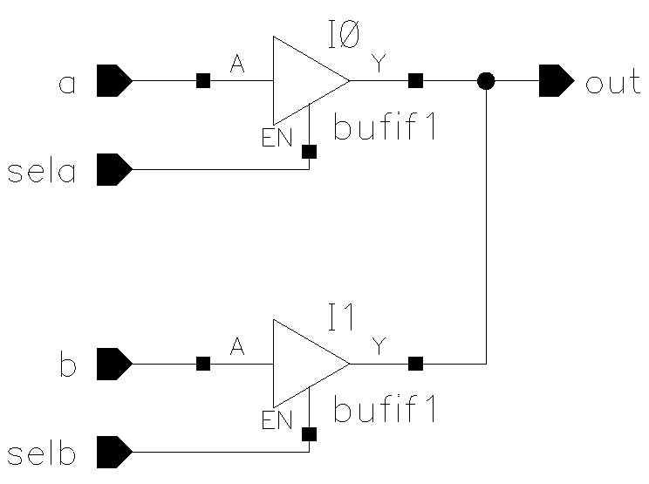
Tri-State
The value z
  always @ (sela or a)
    if (sela)
        out = a ;
    else
        out = 1’bz ;
Another block
  always @(selb or b)
    if(selb)
        out =b ;
    else
        out = 1’bz ;
assign out = (sela)? a: 1’bz ;

Slide 64
Keywords
Note : All keywords are defined in lower case
Examples :
module, endmodule
input, output, inout
reg, integer, real, time
not, and, nand, or, nor, xor
parameter
begin, end

